Slide 1
MICROPROGRAMMED CONTROL
  Control Memory
  Sequencing Microinstructions
  Microprogram Example
  Design of Control Unit
  Microinstruction Format
  Nanostorage and Nanoprogram

Slide 2
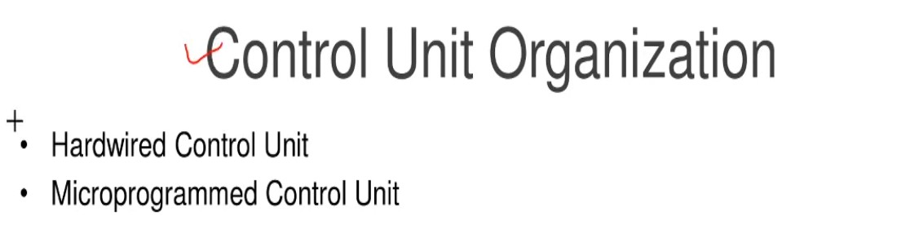

Slide 3
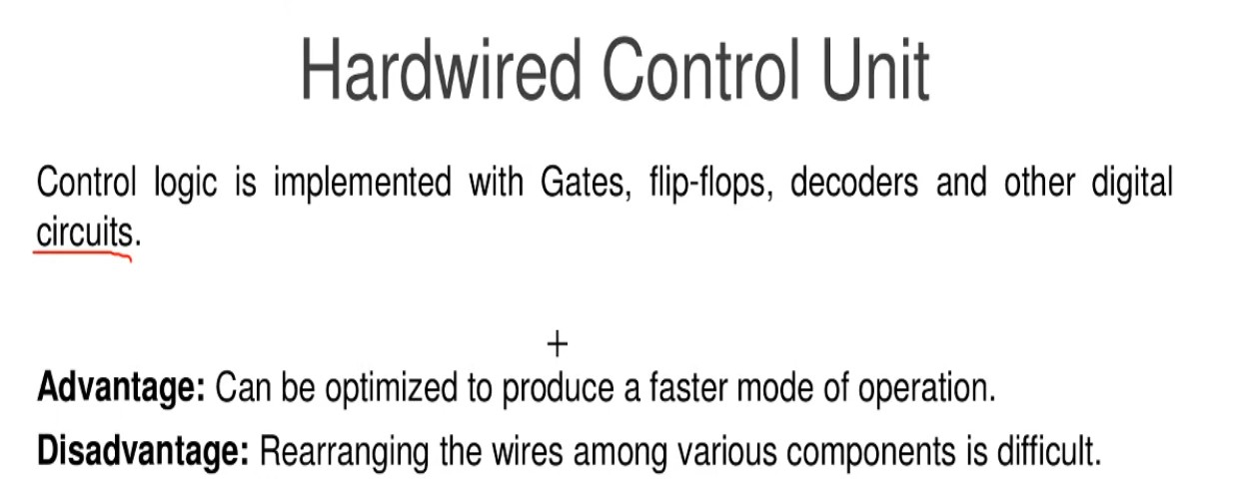

Slide 4
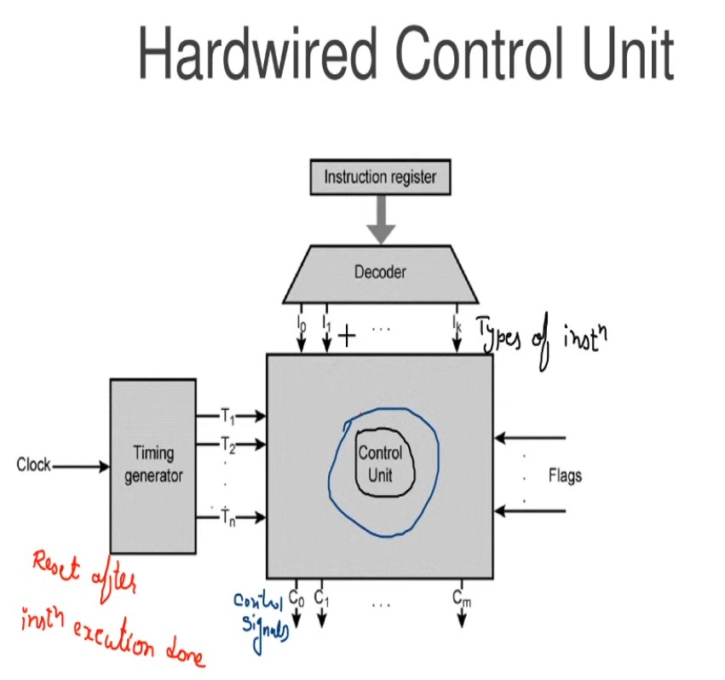

Slide 5
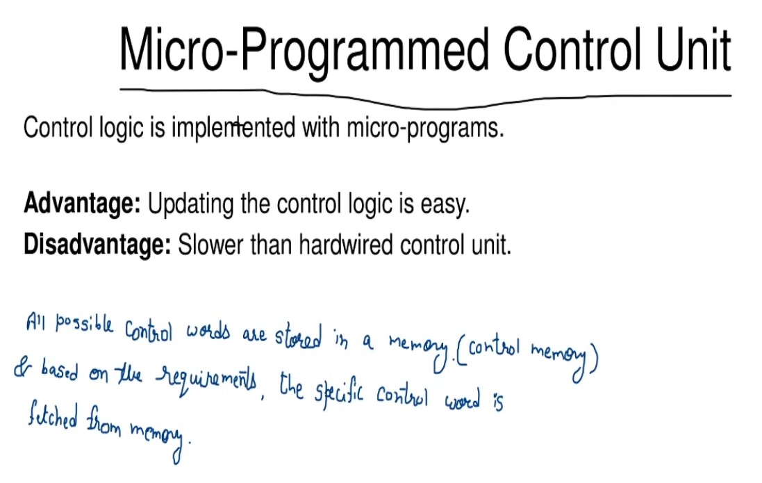

Slide 6
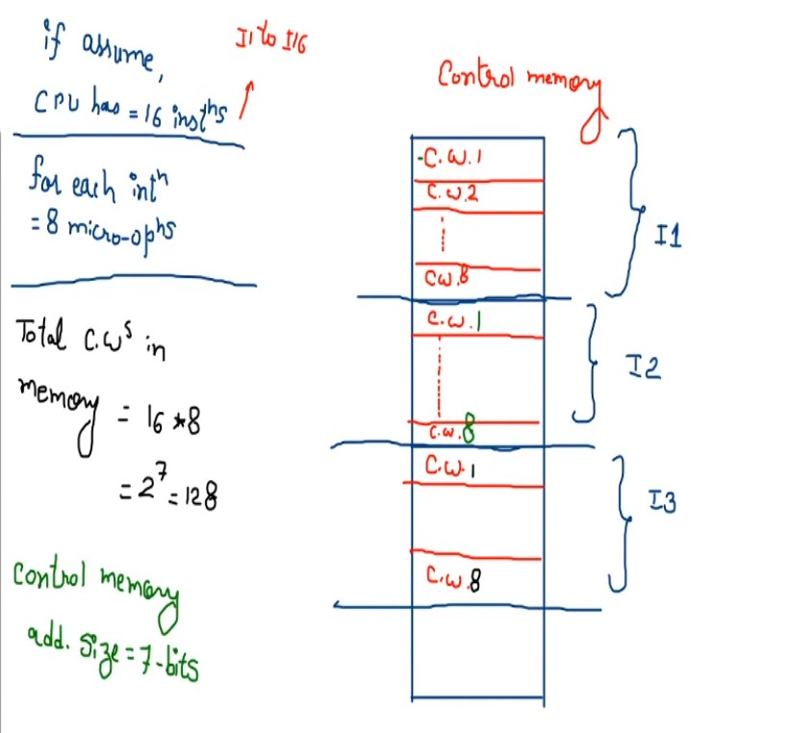

Slide 7
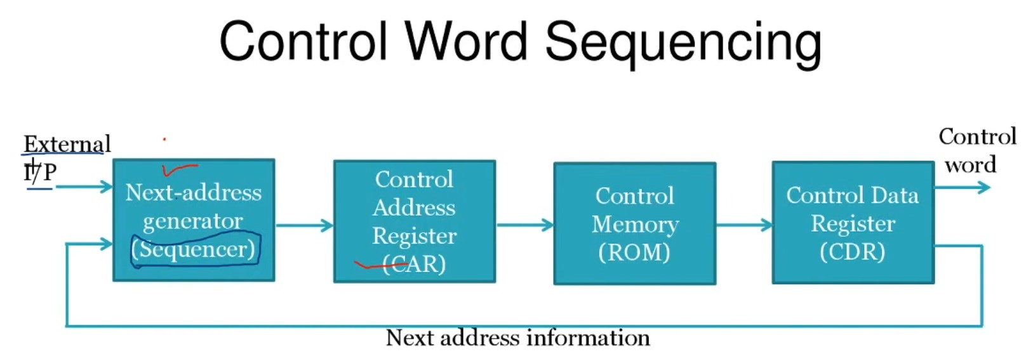

Slide 8
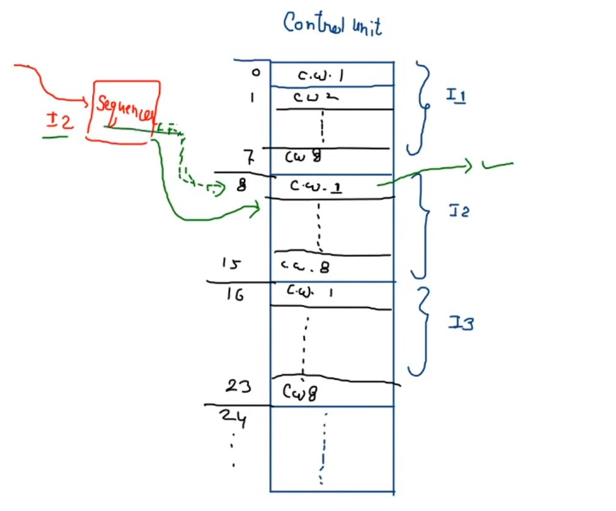

Slide 9
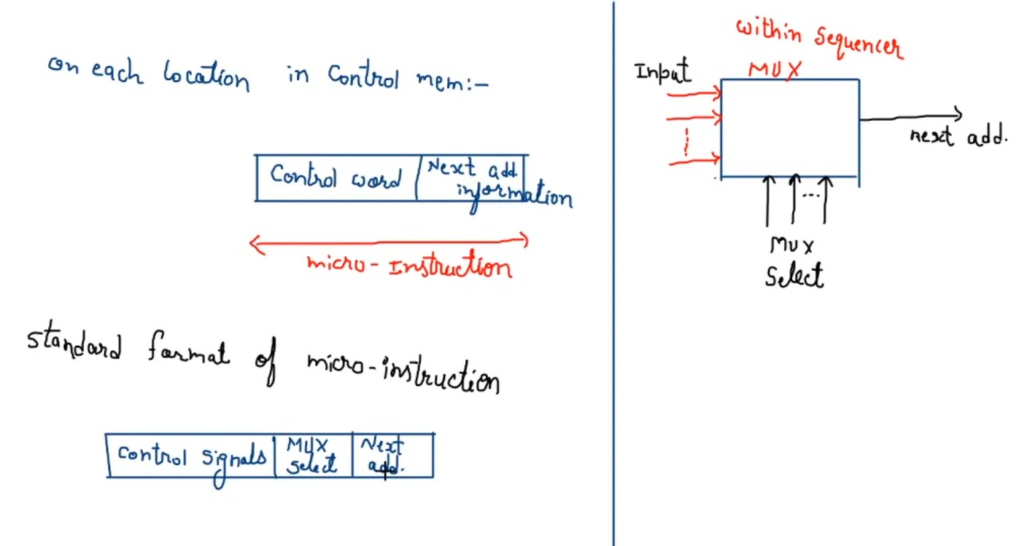

Slide 10
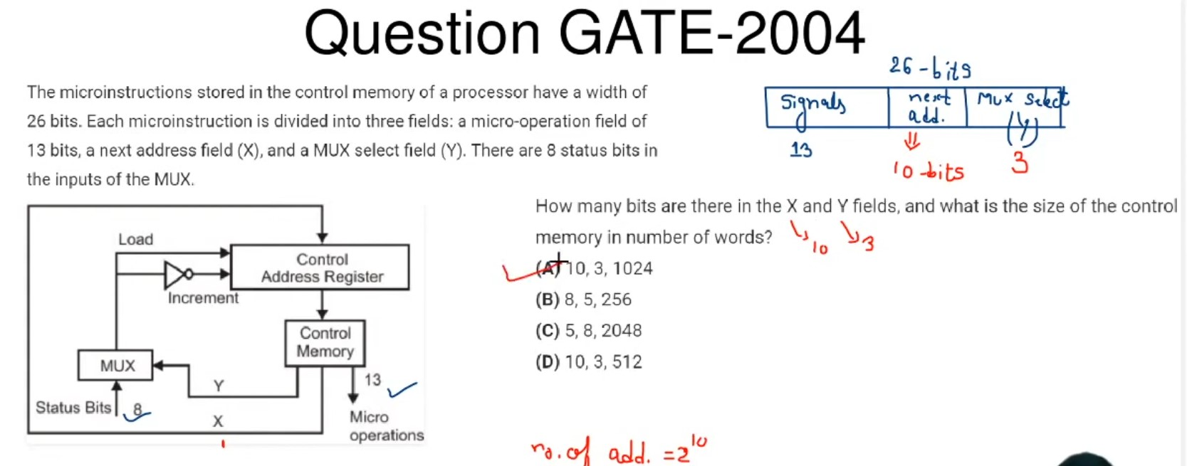

Slide 11
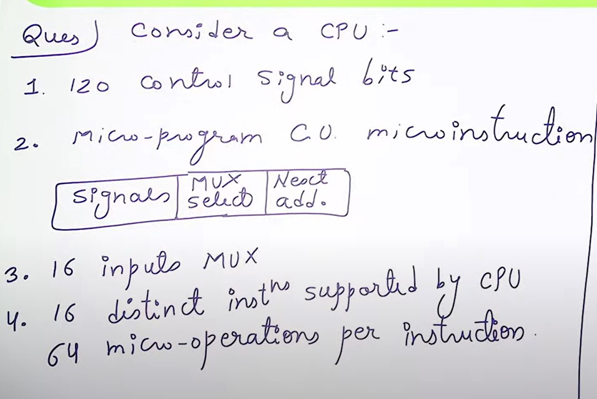

Slide 12
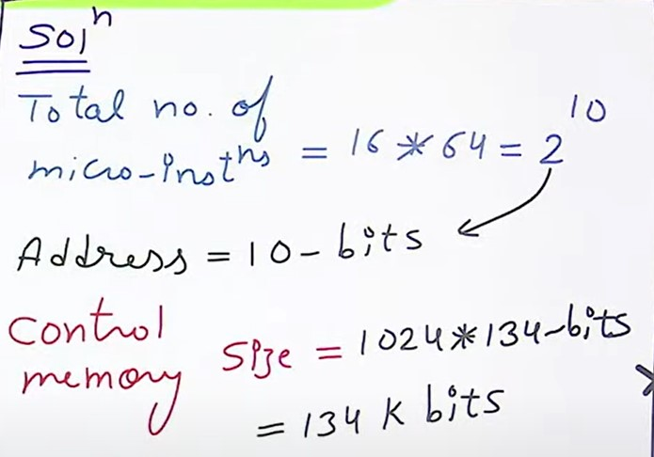

Slide 13
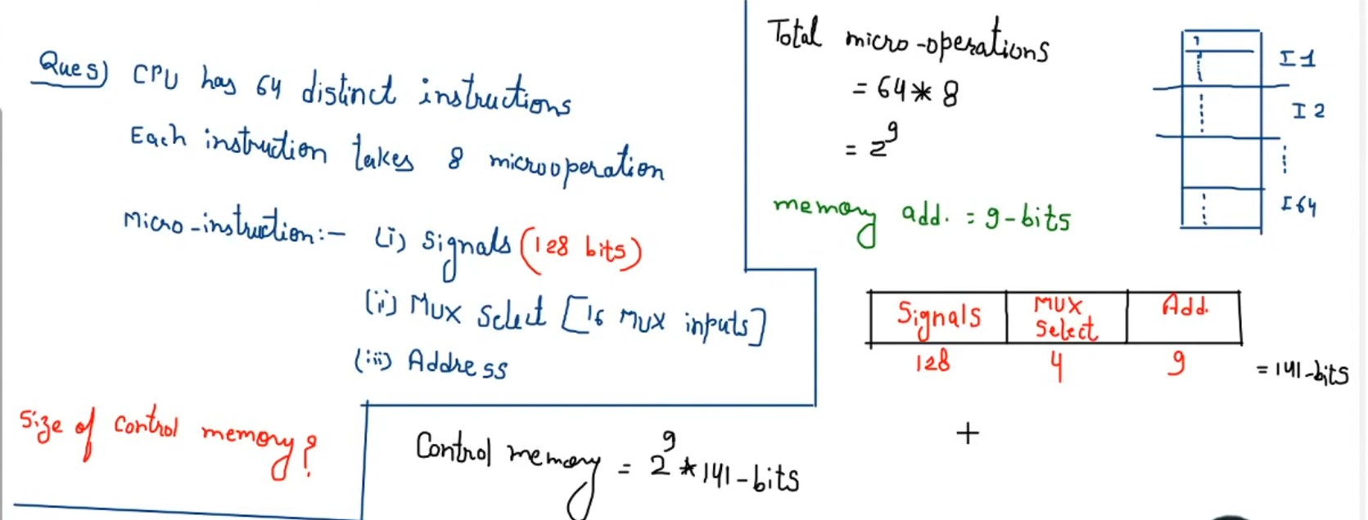

Slide 14
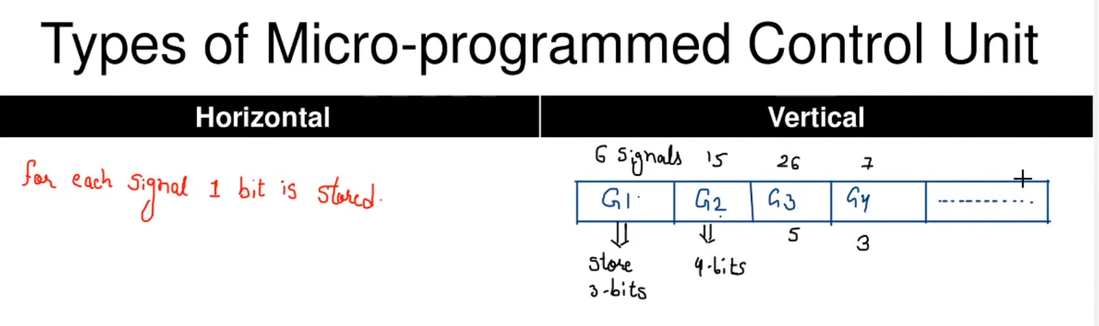

Slide 15


Slide 16
COMPARISON OF CONTROL UNIT IMPLEMENTATIONS
Implementation of Control Unit
Control Unit Implementation
Combinational Logic Circuits (Hard-wired)
Control Data
Memory
I R
Status F/Fs
Control Unit's State
Timing State
Combinational
Control
Logic Circuits
Points
CPU
Ins. Cycle State
Microprogram
M
Control Data
e
m
Status F/Fs
o
I R
r
y
C
Control
C
C
Next Address
S
Storage
S
D
P
CPU
Generation
A
(μ-program
D
s
Logic
R
memory)
R
}

Slide 17
TERMINOLOGY
Microprogram
- Program stored in memory that generates all the control signals required
to execute the instruction set correctly
- Consists of microinstructions
Microinstruction
- Contains a control word and a sequencing word
Control Word - All the control information required for one clock cycle
Sequencing Word - Information needed to decide
the next microinstruction address
- Vocabulary to write a microprogram
Control Memory(Control Storage: CS)
- Storage in the microprogrammed control unit to store the microprogram
Writeable Control Memory(Writeable Control Storage:WCS)
- CS whose contents can be modified
-> Allows the microprogram can be changed
-> Instruction set can be changed or modified
Dynamic Microprogramming
- Computer system whose control unit is implemented with
a microprogram in WCS
- Microprogram can be changed by a systems programmer or a user

Slide 18
TERMINOLOGY
Sequencer (Microprogram Sequencer)
A Microprogram Control Unit that determines
the Microinstruction Address to be executed
in the next clock cycle
- In-line Sequencing
- Branch
- Conditional Branch
- Subroutine
- Loop
- Instruction OP-code mapping

Slide 19
MICROINSTRUCTION SEQUENCING
Sequencing
Instruction code
Mapping
logic
Status
bits
Branch
MUX
Multiplexers
logic
select
Subroutine
register
(SBR)
Control address register
(CAR)
Incrementer
Control memory (ROM)
select a status
bit
Branch address
Microoperations
Sequencing Capabilities Required in a Control Storage
- Incrementing of the control address register
- Unconditional and conditional branches
- A mapping process from the bits of the machine
instruction to an address for control memory
- A facility for subroutine call and return

Slide 20
CONDITIONAL BRANCH
Sequencing
Load address
Control address register
Increment
MUX
Control memory
...
Status
(condition)
bits
Condition select
Micro-operations
Next address
Conditional Branch
If Condition is true, then Branch (address from
the next address field of the current microinstruction)
else Fall Through
Conditions to Test: O(overflow), N(negative),
Z(zero), C(carry), etc.
Unconditional Branch
Fixing the value of one status bit at the input of the multiplexer to 1

Slide 21
MAPPING OF INSTRUCTIONS
Sequencing
Direct Mapping
Address
OP-codes of Instructions
0000
0001
0010
0011
0100
ADD Routine
ADD
AND
LDA
STA
BUN
0000
0001
0010
0011
0100
AND Routine
.
.
.
LDA Routine
STA Routine
BUN Routine
Control
Storage
Mapping
Bits
10 xxxx 010
Address
10 0000 010
ADD Routine
10 0001 010
AND Routine
10 0010 010
LDA Routine
10 0011 010
STA Routine
10 0100 010
BUN Routine

Slide 22
MAPPING OF INSTRUCTIONS TO MICROROUTINES
Sequencing
Mapping from the OP-code of an instruction to the
address of the Microinstruction which is the starting
microinstruction of its execution microprogram
Machine
Instruction
OP-code
1 0 1 1 Address
Mapping bits
0 x x x x 0 0
0 1 0 1 1 0 0
Microinstruction
address
Mapping function implemented by ROM or PLA
OP-code
Mapping memory
(ROM or PLA)
Control address register
Control Memory

Slide 23
MICROPROGRAM EXAMPLE
Microprogram
Computer Configuration
MUX
10
0
AR
Address
Memory
10
0
2048 x 16
PC
MUX
6
0
6
0
15
0
DR
SBR
CAR
Control memory
Arithmetic
logic and
shift unit
128 x 20
Control unit
15
0
AC

Slide 24
MACHINE INSTRUCTION FORMAT
Microprogram
Machine instruction format
15
14
11
10
0
I
Opcode
Address
Sample machine instructions
Symbol OP-code Description
EA is the effective address
  ADD 0000 AC ← AC + M[EA]
  BRANCH 0001 if (AC < 0) then (PC ← EA)
  STORE 0010 M[EA] ← AC
  EXCHANGE 0011 AC ← M[EA], M[EA] ← AC
Microinstruction Format
3
3
3
2
2
7
F1
F2
F3
CD
BR
AD
F1, F2, F3: Microoperation fields
CD: Condition for branching
BR: Branch field
AD: Address field

Slide 25
MICROINSTRUCTION FIELD DESCRIPTIONS - F1,F2,F3
Microprogram
F1 Microoperation Symbol
000 None NOP
001 AC ← AC + DR ADD
010 AC ← 0 CLRAC
011 AC ← AC + 1 INCAC
100 AC ← DR DRTAC
101 AR ← DR(0-10) DRTAR
110 AR ← PC PCTAR
111 M[AR] ← DR WRITE
F2 Microoperation Symbol
000 None NOP
001 AC ← AC - DR SUB
010 AC ← AC ∨ DR OR
011 AC ← AC ∧ DR AND
100 DR ← M[AR] READ
101 DR ← AC ACTDR
110 DR ← DR + 1 INCDR
111 DR(0-10) ← PC PCTDR
F3 Microoperation Symbol
000 None NOP
001 AC ← AC ⊕ DR XOR
010 AC ← AC’ COM
011 AC ← shl AC SHL
100 AC ← shr AC SHR
101 PC ← PC + 1 INCPC
110 PC ← AR ARTPC
111 Reserved

Slide 26
MICROINSTRUCTION FIELD DESCRIPTIONS - CD, BR
Microprogram
CD Condition Symbol Comments
00 Always = 1 U Unconditional branch
01 DR(15) I Indirect address bit
10 AC(15) S Sign bit of AC
11 AC = 0 Z Zero value in AC
  BR Symbol Function
  00 JMP CAR ← AD if condition = 1
  CAR ← CAR + 1 if condition = 0
  01 CALL CAR ← AD, SBR ← CAR + 1 if condition = 1
  CAR ← CAR + 1 if condition = 0
  10 RET CAR ← SBR (Return from subroutine)
  11 MAP CAR(2-5) ← DR(11-14), CAR(0,1,6) ← 0

Slide 27
SYMBOLIC MICROINSTRUCTIONS
Microprogram
Symbols are used in microinstructions as in assembly language
A symbolic microprogram can be translated into its binary equivalent by a microprogram assembler.
Sample Format
five fields: label; micro-ops; CD; BR; AD
  Label: may be empty or may specify a symbolic address terminated with a colon
  Micro-ops: consists of one, two, or three symbols
  separated by commas
  CD: one of {U, I, S, Z}, where U: Unconditional Branch
  I: Indirect address bit
  S: Sign of AC
  Z: Zero value in AC
  BR: one of {JMP, CALL, RET, MAP}
  AD: one of {Symbolic address, NEXT, empty}

Slide 28
SYMBOLIC MICROPROGRAM - FETCH ROUTINE
Microprogram
During FETCH, Read an instruction from memory
and decode the instruction and update PC
Sequence of microoperations in the fetch cycle:
AR ← PC
DR ← M[AR], PC ← PC + 1
AR ← DR(0-10), CAR(2-5) ← DR(11-14), CAR(0,1,6) ← 0
Symbolic microprogram for the fetch cycle:
FETCH:
ORG 64
PCTAR U JMP NEXT
READ, INCPC U JMP NEXT
DRTAR U MAP
Binary equivalents translated by an assembler
Binary
address F1 F2 F3 CD BR AD
1000000 110 000 000 00 00 1000001
1000001 000 100 101 00 00 1000010
1000010 101 000 000 00 11 0000000

Slide 29
SYMBOLIC MICROPROGRAM
Microprogram
Control Storage: 128 20-bit words
The first 64 words: Routines for the 16 machine instructions
The last 64 words: Used for other purpose (e.g., fetch routine and other subroutines)
Mapping: OP-code XXXX into 0XXXX00, the first address for the 16 routines are
0(0 0000 00), 4(0 0001 00), 8, 12, 16, 20, ..., 60
Partial Symbolic Microprogram
Label Microops CD BR AD
ADD:
BRANCH:
OVER:
STORE:
EXCHANGE:
FETCH:
INDRCT:
ORG 0
NOP
READ
ADD
ORG 4
NOP
NOP
NOP
ARTPC
ORG 8
NOP
ACTDR
WRITE
ORG 12
NOP
READ
ACTDR, DRTAC
WRITE
ORG 64
PCTAR
READ, INCPC
DRTAR
READ
DRTAR
I
U
U
S
U
I
U
I
U
U
I
U
U
U
U
U
U
U
U
CALL
JMP
JMP
JMP
JMP
CALL
JMP
CALL
JMP
JMP
CALL
JMP
JMP
JMP
JMP
JMP
MAP
JMP
RET
INDRCT
NEXT
FETCH
OVER
FETCH
INDRCT
FETCH
INDRCT
NEXT
FETCH
INDRCT
NEXT
NEXT
FETCH
NEXT
NEXT
NEXT

Slide 30
BINARY MICROPROGRAM
Microprogram
  Address Binary Microinstruction
  Micro Routine Decimal Binary F1 F2 F3 CD BR AD
ADD 0 0000000 000 000 000 01 01 1000011
  1 0000001 000 100 000 00 00 0000010
  2 0000010 001 000 000 00 00 1000000
  3 0000011 000 000 000 00 00 1000000
BRANCH 4 0000100 000 000 000 10 00 0000110
  5 0000101 000 000 000 00 00 1000000
  6 0000110 000 000 000 01 01 1000011
  7 0000111 000 000 110 00 00 1000000
STORE 8 0001000 000 000 000 01 01 1000011
  9 0001001 000 101 000 00 00 0001010
  10 0001010 111 000 000 00 00 1000000
  11 0001011 000 000 000 00 00 1000000
EXCHANGE 12 0001100 000 000 000 01 01 1000011
  13 0001101 001 000 000 00 00 0001110
  14 0001110 100 101 000 00 00 0001111
  15 0001111 111 000 000 00 00 1000000
FETCH 64 1000000 110 000 000 00 00 1000001
  65 1000001 000 100 101 00 00 1000010
  66 1000010 101 000 000 00 11 0000000
INDRCT 67 1000011 000 100 000 00 00 1000100
  68 1000100 101 000 000 00 10 0000000
This microprogram can be implemented using ROM

Slide 31
DESIGN OF CONTROL UNIT
- DECODING ALU CONTROL INFORMATION -
Design of Control Unit
microoperation fields
F1
F2
F3
3 x 8 decoder
3 x 8 decoder
3 x 8 decoder
7
6
5
4
3
2
1
0
7
6
5
4
3
2
1
0
7
6
5
4
3
2
1
0
AND
AC
DR
ADD
Arithmetic
DRTAC
logic and
shift unit
From
From
PCTAR
DRTAR
PC
DR(0-10)
Load
AC
Select
0
1
Multiplexers
Load
AR
Clock

Slide 32
MICROPROGRAM SEQUENCER
- NEXT MICROINSTRUCTION ADDRESS LOGIC -
Design of Control Unit
Branch, CALL Address
External
RETURN form Subroutine
(MAP)
In-Line
S₁S₀ Address Source
00 CAR + 1, In-Line
01 SBR RETURN
10 CS(AD), Branch or CALL
11 MAP
3
2
1
0
L
S
SBR
Subroutine
CALL
1
MUX1
S
0
Address
source
selection
Incrementer
Clock
CAR
Control Storage
MUX-1 selects an address from one of four sources and routes it into a CAR
- In-Line Sequencing → CAR + 1
- Branch, Subroutine Call → CS(AD)
- Return from Subroutine → Output of SBR
- New Machine instruction → MAP

Slide 33
MICROPROGRAM SEQUENCER
- CONDITION AND BRANCH CONTROL -
Design of Control Unit
From
CPU
1
Test
L
L(load SBR with PC) for subroutine Call
I
MUX2
T
S
BR field
of CS
Input
Z
Select
I₀
logic
S₀
S₁
for next address
selection
I₁
CD Field of CS
Input Logic
I₀I₁T Meaning Source of Address S₁S₀ L
000 In-Line CAR+1 00 0
001 JMP CS(AD) 10 0
010 In-Line CAR+1 00 0
011 CALL CS(AD) and SBR <- CAR+1 10 1
10x RET SBR 01 0
11x MAP DR(11-14) 11 0
S₀ = I₀
S₁ = I₀I₁ + I₀’T
L = I₀’I₁T

Slide 34
MICROPROGRAM SEQUENCER
Design of Control Unit
External
(MAP)
I₀
L
3
2
1
0
I₁
Input
S₁
SBR
Load
logic
S₀
MUX1
T
1
Incrementer
I
MUX2
Test
S
Z
Select
Clock
CAR
Control memory
Microops
CD
BR
AD
. . .
. . .

